Slide 1


CS 6831 Designing Secure Cryptography
Tom Ristenpart

Slide 2
Authenticated encryption so far
CPA-only encryption insufficient due to active attacks
Trivial manipulation attacks violating integrity
Padding oracle attacks
Authenticated encryption is symmetric encryption with stronger security properties
OCB
Generic composition approaches
Encrypt-then-MAC, MAC-then-Encrypt, Encrypt-and-MAC
Today:
Generic composition in practice and theory
More advanced security goals

Slide 3
Generic composition
Combine CPA-secure scheme with a UF-CMA MAC
(1)
M
Several ways to combine:
(1) encrypt-then-mac
(2) mac-then-encrypt
(3) encrypt-and-mac
K1
Enc
MAC
K2
C
T
(3)
M
(2)
M
M || T
K1
Enc
MAC
K2
K1
Enc
MAC
K2
C
T
C
Notes:
X here means there exist CPA-secure SE and/or UF-CMA MAC such that combination is insecure

Slide 4
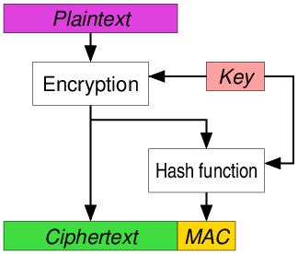
Encrypt-then-MAC
Wikipedia entry for authenticated encryption shows this diagram:
https://en.wikipedia.org/wiki/Authenticated_encryption

Slide 5
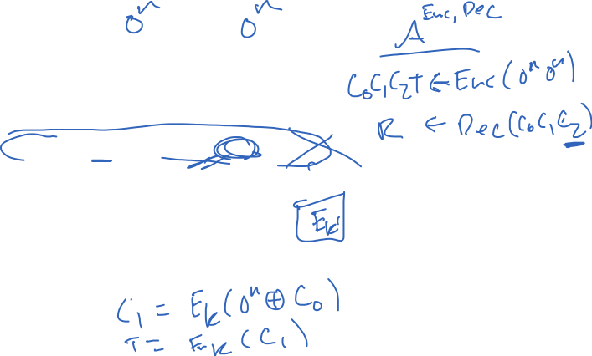
Key separation is critical. Using same key with CBC-Mode + CBC-MAC:
M1
M2
IV
E_{K}
E_{K}
C0
C1
C2
T
E_{K}
E_{K}
E_{K}
Notes:
Attack:
C0’ = IV + M1
C1’ = M2
T’ = C2

Slide 6
Key separation is critical. Using same key with CBC-Mode + CBC-MAC:
M1
M2
IV
E_{K}
E_{K}
C0
C1
C2
T
E_{K}
E_{K}
E_{K}
Must derive separate keys: K_{enc} = AES(K,0^{n}) K_{mac} = AES(K,1^{n})

Slide 7
Generic composition
Combine CPA-secure scheme with a UF-CMA MAC
(1)
M
Several ways to combine:
(1) encrypt-then-mac
(2) mac-then-encrypt
(3) encrypt-and-mac
K1
Enc
MAC
K2
C
T
(3)
M
(2)
M
M || T
K1
Enc
MAC
K2
K1
Enc
MAC
K2
C
T
C
Notes:
X here means there exist CPA-secure SE and/or UF-CMA MAC such that combination is insecure

Slide 8
TLS 1.2 record protocol: MAC-Encode-Encrypt (MEE)
SQN +
comp method
Payload
Associated data:
Information that is authenticated but not encrypted
Authenticated encryption with associated data (AEAD)
MAC
Payload
MAC tag
Padding
Enc
Header
Ciphertext
MAC
HMAC-MD5, HMAC-SHA1, HMAC-SHA256
Enc
CBC-AES128, CBC-AES256, CBC-3DES, RC4-128

Slide 9
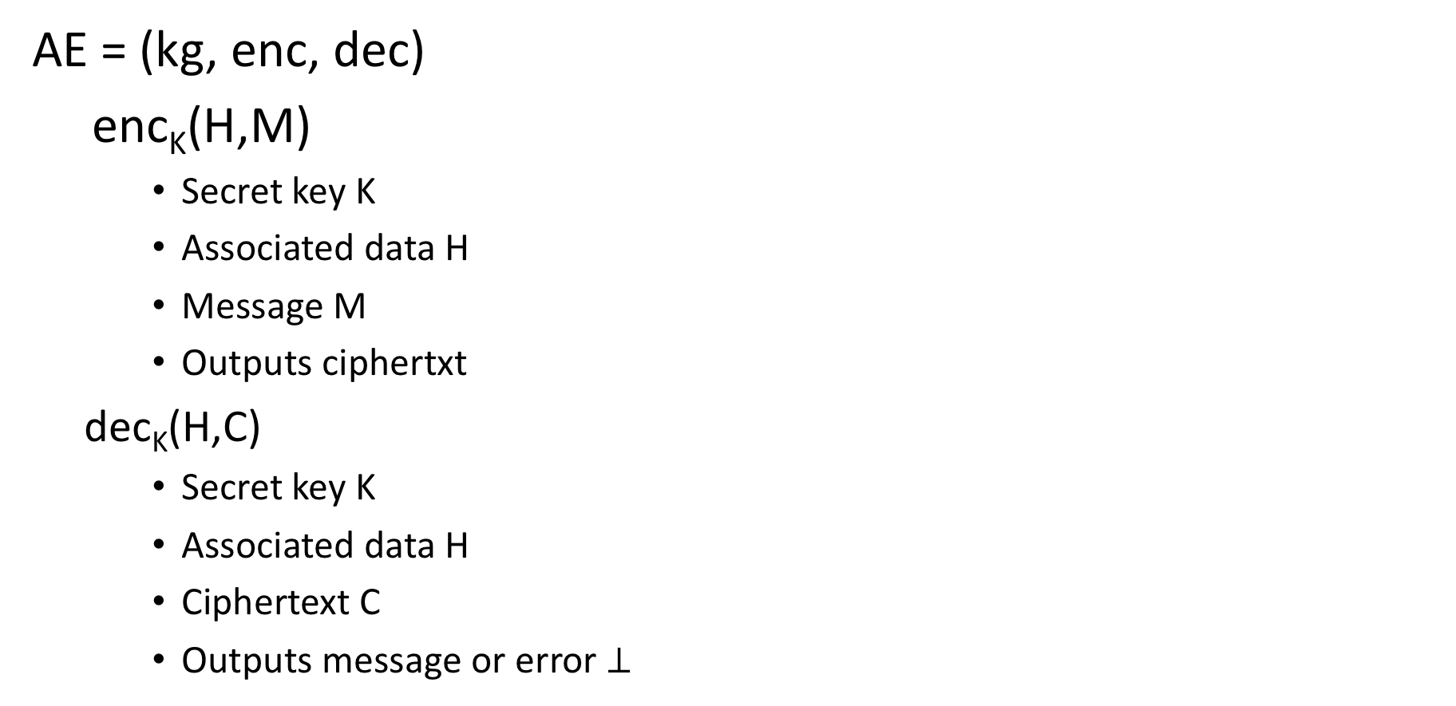
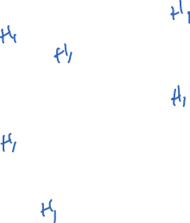
Authenticated encryption with associated data (AEAD)
AE = (kg, enc, dec)
enc_{K}(H,M)
Secret key K
Associated data H
Message M
Outputs ciphertxt
dec_{K}(H,C)
Secret key K
Associated data H
Ciphertext C
Outputs message or error $⊥$

Slide 10
Authenticated encryption with associated data (AEAD)
AE = (kg, enc, dec)
enc_{K}(H,M)
Secret key K
Associated data H
Message M
Outputs ciphertxt
dec_{K}(H,C)
Secret key K
Associated data H
Ciphertext C
Outputs message or error $⊥$

Slide 11
TLS 1.2 record protocol: MAC-Encode-Encrypt (MEE)
Padding is not MAC’d.
Implementations must
handle padding checks
very carefully.
SQN +
comp method
Payload
Associated data:
Information that is authenticated but not encrypted
Authenticated encryption with associated data (AEAD)
MAC
Payload
MAC tag
Padding
Enc
Header
Ciphertext
MAC
HMAC-MD5, HMAC-SHA1, HMAC-SHA256
Enc
CBC-AES128, CBC-AES256, CBC-3DES, RC4-128

Slide 12
Conflicting results about TLS 1.2 record protocol
[Namprempre, Bellare 2000]: MAC-then-Encrypt not secure, in general
Exist ROR-secure encryption for which MAC-then-Encrypt is not CTXT
Analyses arguing security when using CBC mode
[Krawczyk 2001]
[Canvel et al. 2003]: recover passwords sent over TLS 1.2 record protocol using padding oracle attack

Slide 13


Padding oracle attacks against MAC-then-Encrypt
H, R, C0 , C1
Dec( K1 K2, H, C ):
M <- CBC-Dec(K,C)
P <- RemoveLastByte(M)
while i < int(P):
P’ <- RemoveLastByte(M)
If P’ != P then
Return PAD_ERROR
i++
T <- RemoveLast20Bytes(M)
If HMAC(K1,H,M) != T then
Return MAC_ERROR
Return M
PAD_ERROR
H, R , C0⨁1 , C1
PAD_ERROR
Adversary
obtains
ciphertext
C = C0,C1,C2,C3
for header H
Let R be arbitrary
n bits
H, R , C0⨁2 , C1
PAD_ERROR
…
H, R , C0⨁i , C1
MAC_ERROR
Actually: each error forces TLS session to abort. Each query above is for separate session (“multi-session attack”)

Slide 14
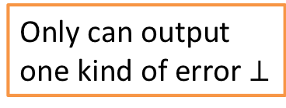
Standard models don’t cover padding oracle attacks
Dec( K1 K2, H, C ):
M <- CBC-Dec(K,C)
P <- RemoveLastByte(M)
while i < int(P):
P’ <- RemoveLastByte(M)
If P’ != P then
Return PAD_ERROR
i++
T <- RemoveLast20Bytes(M)
If HMAC(K1,H,M) != T then
Return MAC_ERROR
Return M
Only can output
one kind of error $⊥$

Slide 15
Standard models don’t cover padding oracle attacks
Dec( K1 K2, H, C ):
M <- CBC-Dec(K,C)
P <- RemoveLastByte(M)
while i < int(P):
P’ <- RemoveLastByte(M)
If P’ != P then
Return MAC_ERROR
i++
T <- RemoveLast20Bytes(M)
If HMAC(K1,H,M) != T then
Return MAC_ERROR
Return M
RFC 5246:
“The receiver MUST check this padding and MUST use the bad_record_mac alert to indicate padding errors.”
Only can output
one kind of error $⊥$

Slide 16
Timing outside standard models as well…
From [Canvel et al. 2003] paper

Slide 17
Timing countermeasures
Dec( K1 K2, H, C ):
M <- CBC-Dec(K,C)
P <- RemoveLastByte(M)
while i < int(P):
P’ <- RemoveLastByte(M)
If P’ != P then
HMAC( K1, H, M)
Return MAC_ERROR
i++
T <- RemoveLast20Bytes(M)
If HMAC(K1,H,M) != T then
Return MAC_ERROR
Return M
RFC 5246:
“…implementations MUST ensure that record processing time is essentially the same whether or not the padding is correct.”
RFC 5246:
“This leaves a small timing channel, since MAC performance depends to some extent on the size of the data fragment, but it is not believed to be large enough to be exploitable”
[AlFardan, Paterson 2013]

Slide 18
Secure Shell (SSH) protocol
[Bellare et al. 2002]
[Albrecht et al. 2009]
[Paterson, Watson 2010]

Slide 19


SSH record layer
[Albrecht et al. 2009]

Slide 20
Other AE concepts
Stateful symmetric encryption
Use counter instead of IV. Recipient maintains state.
Security models complicated (capture things like reordering, etc.)
Nonce-based AE(AD) [Rogaway 2004]
Security assuming any non-repeating nonce
Length-hiding AE(AD) [Paterson, Ristenpart, Shrimpton 2011]
Formalize security goals for hiding small diffs in lengths via extra padding
Misuse-resistant nonce-based AE(AD) [Rogaway, Shrimpton 2006]
Still maintain security when IV (or counter) repeats: get everything but plaintext repetition being revealed
Robust encryption (perhaps: committing encryption?) [Farshim et al. 2017]
Ciphertexts should only be decryptable under one key

Slide 21
Synthetic IV (SIV) mode
[Rogaway, Shrimpton 2006]
Encryption:
Decryption:
Misuse-resistant schemes cannot be “online”
Online schemes can just leak length of common prefix

Slide 22
Summary of some dedicated AEAD schemes
Attack | Inventors | Notes | Nonce-based | Misuse-resistant | Robust
OCB | Rogaway | One-pass | Yes | No | No
AES-CTR-then-HMAC | ⁻⁻ |  | No | No | Yes*
GCM | McGrew, Viega | CTR mode plus specialized universal-hash-based MAC called | Yes | No | No
SIV | Rogaway, Shrimpton | Not online, two full passes | Yes | Yes | No
AES-GCM-SIV | Gueron, Lindell | SIV using AES-GCM & a few efficiency tweaks; misuse-resistant | Yes | Yes | No
ASCON | Dobraunig et al. | Based on lightweight cipher | Yes | Prefix leaks | Yes
AEGIS | Wu, Preneel | Uses AES round function | Yes (?) | No | ???
COLM | Andreeva et al. | Parallelizable cipher with nonce-repeat prefix-only leakage | Yes | Prefix leaks | No?
* If you derive encrypt and MAC keys from single key

Slide 26
Example dedicated AEAD schemes
Attack | Inventors | Notes
OCB (Offset Codebook) | Rogaway | One-pass
GCM (Galios Counter Mode) | McGrew, Viega | CTR mode plus specialized universal-hash-based MAC
CWC | Kohno, Viega, Whiting | CTR mode plus Carter-Wegman MAC
CCM | Housley, Ferguson, Whiting | CTR mode plus CBC-MAC
EAX | Wagner, Bellare, Rogaway | CTR mode plus OMAC
AES-GCM-SIV | Gueron, Lindell | SIV using AES-GCM & a few efficiency tweaks; misuse-resistant
CAESER competition recently concluded, lots of new candidates for AEAD schemes both misuse-resistant and standard

